Slide 1

INSTITUTE - UIE
DEPARTMENT- ACADEMIC UNIT-2
Bachelor of Engineering (Computer Science & Engineering)
Subject Name: Object Oriented Programming using C++
Code:20CST151
Unit-3
Topic: Throwing an Exception, Catching an Exception (All types of throw and catch), Rethrow Exception
DISCOVER . LEARN . EMPOWER

Slide 2


Object Oriented Programming using C++
Course Objectives
To enable the students to understand various stages and constructs of C++ programming language and relate them to engineering programming problems.
To improve their ability to analyze and address variety of problems in programming domains.

Slide 3



Course Outcomes
CO Number | Title | Level
CO1 | Provide the environment that allows students to understand object-oriented programming Concepts. | Understand
CO2 | Demonstrate basic experimental skills for differentiating between object-oriented and procedural programming paradigms and the advantages of object-oriented programs. | Remember
CO3 | Demonstrate their coding skill on complex programming concepts and use it for generating solutions for engineering and mathematical problems. | Understand
CO4 | Develop skills to understand the application of classes, objects, constructors, destructors, inheritance, operator overloading and polymorphism, pointers, virtual functions, exception handling, file operations and handling. | Understand

Slide 4
Scheme of Evaluation
Sr. No. | Type of Assessment Task | Weightage of actual conduct | Frequency of Task | Final Weightage in Internal Assessment (Prorated Marks) | Remarks
1. | Assignment* | 10 marks of each assignment | One Per Unit | 10 marks | As applicable to course types depicted above.
2. | Time Bound Surprise Test | 12 marks for each test | One per Unit | 4 marks | As applicable to course types depicted above.
3. | Quiz | 4 marks of each quiz | 2 per Unit | 4marks | As applicable to course types depicted above.
4. | Mid-Semester Test** | 20 marks for one MST. | 2 per semester | 20 marks | As applicable to course types depicted above.
5. | Presentation*** |  |  | Non Graded: Engagement Task | Only for Self Study MNGCourses.
6. | Homework | NA | One per lecture topic (of 2 questions) | Non-Graded: Engagement Task | As applicable to course types depicted above.
7. | Discussion Forum | NA | One per Chapter | Non Graded: Engagement Task | As applicable to course types depicted above.
8. | Attendance and Engagement Score on BB | NA | NA | 2 marks

Slide 5
CONTENTS
Types of Exceptions
Throwing an Exception
Catching an Exception (All types of throw and catch)
Rethrow Exception
Notes:
Computer in the diagram is 3rd generation computer. The period of third generation was from 1965-1971. The computers of third generation used Integrated Circuits (ICs) in place of transistors. A single IC has many transistors, resistors, and capacitors along with the associated circuitry. The main features of third generation are −
IC used
More reliable in comparison to previous two generations
Smaller size
Generated less heat
Faster
Lesser maintenance
Costly
AC required
Consumed lesser electricity
Supported high-level language

Slide 6
Types of Exceptions
There are two types of exceptions:
Synchronous exceptions
Asynchronous exceptions
Errors such as: out of range index and overflow fall under the category of synchronous type exceptions.
Those errors that are caused by events beyond the control of the program are called asynchronous exceptions.

Slide 7
Throwing Exceptions
Exceptions can be thrown anywhere within a code block using throw statement. The operand of the throw statement determines a type for the exception and can be any expression and the type of the result of the expression determines the type of exception thrown.
Following is an example of throwing an exception when dividing by zero condition occurs −
double division(int a, int b) {
if( b == 0 ) {
throw "Division by zero condition!";
}
return (a/b);
}

Slide 8
Catching Exceptions
The catch block following the try block catches any exception. You can specify what type of exception you want to catch and this is determined by the exception declaration that appears in parentheses following the keyword catch.
try {
// protected code
} catch( ExceptionName e ) {
// code to handle ExceptionName exception
}
Above code will catch an exception of ExceptionName type. If you want to specify that a catch block should handle any type of exception that is thrown in a try block, you must put an ellipsis, ..., between the parentheses enclosing the exception declaration as follows −
try {
// protected code
} catch(...) {
// code to handle any exception
}

Slide 9
Using Multiple Catch Blocks
Below program contains multiple catch blocks to handle different types of exception in different way.
#include <iostream>
#include<conio.h>
using namespace std;
int main()
{
int x[3] = {-1,2};
for(int i=0; i<2; i++)
{
int ex = x[i];
try
{
if (ex > 0)
// throwing numeric value as exception
throw ex;
else
// throwing a character as exception
throw 'ex';
}
The above program is self-explanatory, if the value of integer in the array x is less than 0, we are throwing a numeric value as exception and if the value is greater than 0, then we are throwing a character value as exception. And we have two different catch blocks to catch those exceptions.
catch (int ex) // to catch numeric exceptions
{
cout << "Integer exception\n";
}
catch (char ex) // to catch character/string exceptions
{
cout << "Character exception\n";
}
}
}
Output:
Integer exception
Character exception

Slide 10
Generalised catch block in C++
Below program contains a generalized catch block to catch any uncaught errors/exceptions. catch(...) block takes care of all type of exceptions.
#include <iostream>
#include<conio.h>
using namespace std;
int main()
{
int x[3] = {-1,2};
for(int i=0; i<2; i++)
{
int ex=x[i];
try
{
if (ex > 0)
throw ex;
In the case above, both the exceptions are being catched by a single catch block. We can even have separate catch blocks to handle integer and character exception along with the generalised catch block.
else
throw 'ex';
}
// generalised catch block
catch (...)
{
cout << "Special exception\n";
}
}
return 0;
}
Output:
Special exception
Special exception

Slide 11
Re-throwing an Exception
It’s possible that an exception handler, upon receiving an exception, might decide either that it cannot process that exception or that it can process the exception only partially.
In such cases, the exception handler can defer the exception handling (or perhaps a portion of it) to another exception handler.
In either case, you achieve this by re throwing the exception via the statement
throw;
Regardless of whether a handler can process an exception, the handler can re throw the exception for further processing outside the handler.

Slide 12
Re-throwing an Exception
#include <iostream>
#include <exception>
using namespace std;
void func1()
{
// throw exception and catch it immediately
try
{
cout << "\n This function throws an exception\n";
throw exception(); //generate exception
} // end try

Slide 13
Re-throwing an Exception
catch(exception &)
{
cout << " exception is catched in 1st catch block"
<< "\n Function func1 re throws exception";
throw; //rethrow exception for further processing
} // end catch
cout << "This also should not print\n";
} // end of func1

Slide 14
Re-throwing an Exception
int main()
{
try
{
cout << "\n main invokes function func1\n";
func1();
cout << "This should not print\n";
} // end try
catch (exception e) // handle exception
{
cout << "\n\n Exception handled in main\n";
} // end catch
cout << " Program control continues after catch in main\n";
} // end main

Slide 15
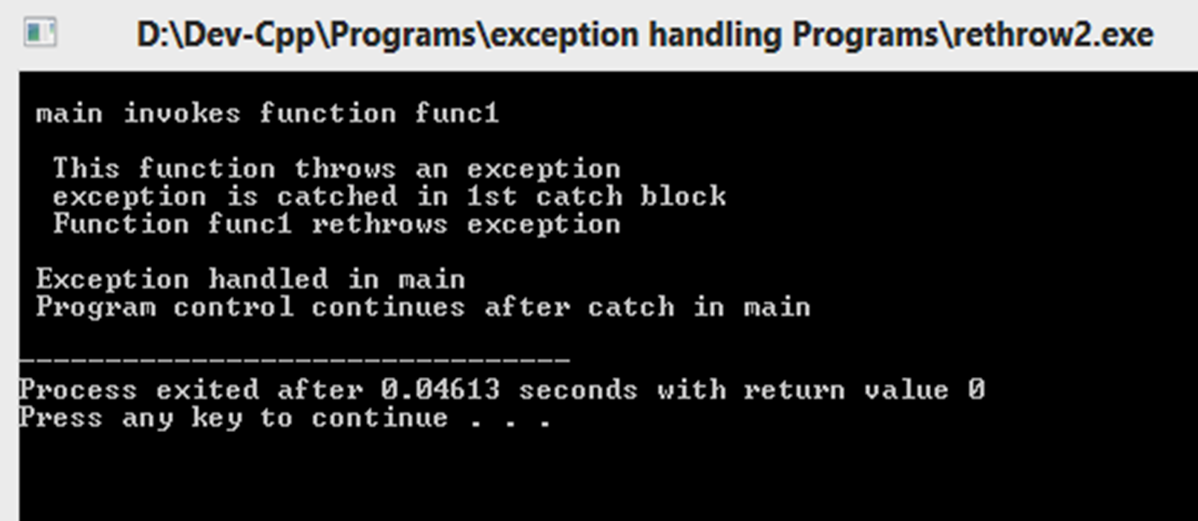
Output:

Slide 16
Applications
Helps in finding and handling run-time anomalies or abnormal conditions that a program encounters during its execution.

Slide 17
Summary
In this lecture we have discussed how to throw exceptions.
We have discussed how to catch exceptions
Moreover, we have learnt about how to rethrow exceptions
We have also learnt about synchronous and asynchronous exceptions

Slide 18
Frequently Asked question
Q1 Describe the way to handle run time error in C++.
Answer: A runtime error is handled in C++ in the following manner:
- Write the code where the error is predicted after the keyword try. - Write the solution if a particular exception occurs in the catch block by specifying a parameter which is thrown from the try block. Or - Throw the error object by using throw(Exception type object) after try keyword.
Describe the way to handle run time error in C++.
Explain the exception specification.
Q2 Explain terminate() and unexpected() function.
Answer: - The terminate() is a library function which by default aborts the program.
- It is called whenever the exception handling mechanism cannot find a handler for a thrown exception.
The unexpected() is called when a function with an exception specification throws an exception of a type that is not listed in the exception specification for the function
- A function declaration without a specification like throw(char*) may throw any type of exception, and one with throw() is not allowed to throw exceptions at all.
- By default unexpected() calls terminate().

Slide 19
Assessment Questions:
1. What is the difference between error and exception?
a) Both are the same
b) Errors can be handled at the run-time but the exceptions cannot
c) Exceptions can be handled at the run-time but the errors cannot
d) Both can be handled during run-time
2. What are the different types of exceptions?
a) 1
b) 2
c) 3
d) 4

Slide 20
Assessment Questions:
3. Which part of the try-catch block is always fully executed?
a) try part
b) catch part
c) finally part
d) throw part
4. Which of the following is an exception in C++?
a) Divide by zero
b) Semicolon not written
c) Variable not declared
d) An expression is wrongly written
5. What is an error in C++?
a) Violation of syntactic and semantic rules of a languages
b) Missing of Semicolon
c) Missing of double quotes
d) Violation of program interface

Slide 21
Discussion forum.
What are the various synchronous and asynchronous exceptions?
Examples of various exception handling scenarios.

Slide 22

REFERENCES
TEXT BOOKS
T1 E Balagurusamy., “Object Oriented Programming in C++”, Tata McGraw-Hill.
T2 Robert Lafore, “Object Oriented Programming in C++”, Waite Group.
REFERENCE BOOKS
R1 Herbert Schildt , “C++- The Complete Reference”, Tata McGraw-Hill 2003, New Delhi.
R2 Bjarne Stroustrup: “The C++ Programming Language” (4th Edition). Addison-Wesley.
R3 Ravichandran , “Programming with C++”,Tata McGraw-Hill Education.
R4 Joyce M. Farrell,” Object Oriented Programming Using C++”, Learning.
R5 Programming Languages: Design and Implementation (4th Edition), by Terrence W. Pratt, Marvin V. Zelkowitz, Pearson.
R6 Programming Language Pragmatics, Third Edition, by Michael L. Scott, Morgan Kaufmann.
Websites:
https://www.sanfoundry.com/cplusplus-programming-questions-answers-exception-handling-1/
https://www.tutorialspoint.com/cplusplus/cpp_exceptions_handling.htm
https://www.geeksforgeeks.org/exception-handling-c/
https://www.studytonight.com/cpp/exception-handling-in-cpp.php

Slide 23
THANK YOU

